Slide 1
Bankruptcy Prediction Project
Exploratory Data Analysis (EDA) and Model Building
Presented by Sudhanshu Suryavanshi
This project aims to explore and analyze a dataset on bankruptcy prediction, with the goal of developing robust machine learning models to accurately forecast the likelihood of a company's bankruptcy. Predicting bankruptcy is crucial for financial stability and effective risk management, as it enables organizations to proactively identify and address potential issues before they escalate.

Slide 2
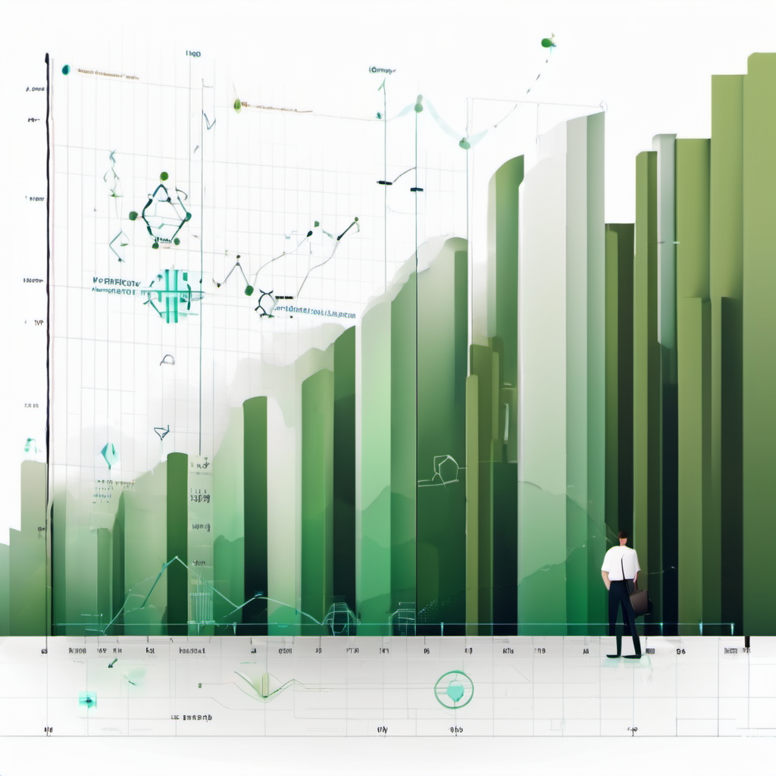
Introduction
Goal
The goal of this machine learning project is to develop a predictive model that can assess the financial health of companies and predict the likelihood of bankruptcy based on various financial attributes. The dataset contains a wide range of financial indicators for different companies, including profitability ratios, liquidity ratios, leverage ratios, and operational efficiency metrics. The prediction of bankruptcy is a phenomenon of increasing interest in firms that stand to lose money because of unpaid debts.

Slide 3
Introduction
Objective
To use machine learning algorithms, and aim to analyze these financial attributes and build a predictive model that can classify companies as either financially healthy or at risk of bankruptcy. By leveraging historical financial data and company performance metrics, this model will help investors, financial analysts, and stakeholders identify early warning signs of financial distress and make informed decisions to mitigate risks.

Slide 4
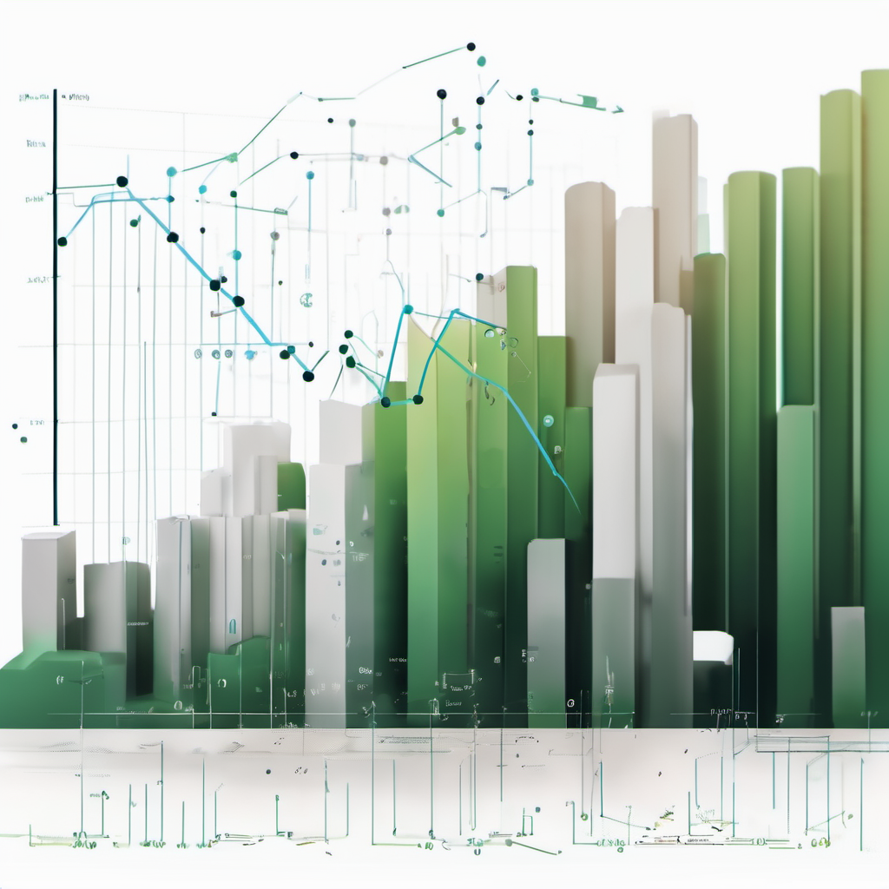
Introduction
Importance of bankruptcy prediction for
financial stability and risk management
Bankruptcy prediction is crucial for financial stability and risk management because it helps financial institutions identify companies or individuals at high risk of defaulting on their financial obligations. By accurately predicting bankruptcy, institutions can:
Take proactive measures to mitigate potential losses.
Make informed decisions regarding lending, investments, and credit risk assessment.
Safeguard financial stability by avoiding exposure to risky borrowers.
Allocate resources more efficiently by focusing on high-risk accounts.

Slide 5
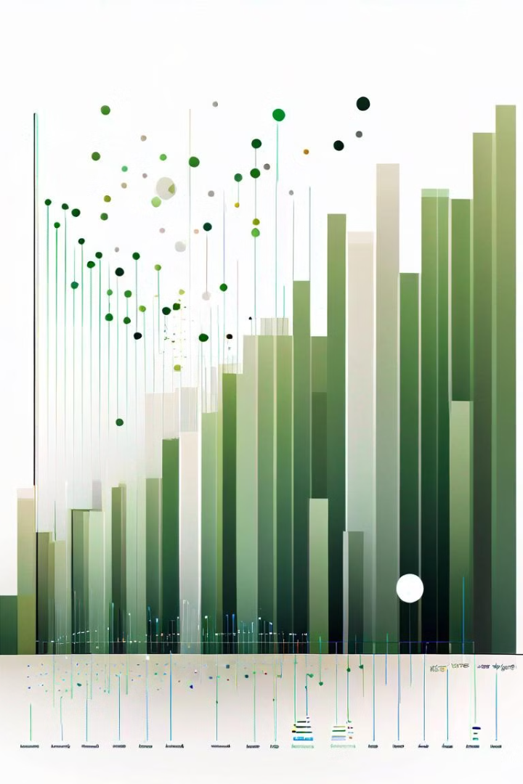
Project Overview
We will analyze the Bankruptcy dataset by loading it into a dataframe and then performing EDA on it, from where we hope to understand the data better and also to understand what parameters are most significant in predicting bankruptcy for a company.
After which we will move on to model building and evaluating various performance parameters to arrive at the model which is best suited for this dataset.

Slide 6
Project Overview
Dataset Overview
The dataset used in this project consists of 6819 records and 95 variables. The key variable of interest is the "Bankrupt" target variable, which indicates whether a company has filed for bankruptcy (1) or not (0).

Slide 7
Project Overview
Dataset Dictionary
The accounting measures are categorized below with their detailed definitions, and how credit risk might be affected:
1.Profitability Ratios: Measure the company's ability to generate profits relative to its revenue, assets, or equity.
2.Liquidity Ratios: Assess the company's ability to meet short-term obligations with its liquid assets.
3.Leverage Ratios: Indicate the extent to which a company relies on debt financing relative to its equity.

Slide 8
Project Overview
Dataset Dictionary
The accounting measures are categorized below with their detailed definitions, and how credit risk might be affected:
4.Activity or Efficiency Ratios: Measure how efficiently a company utilizes its assets to generate sales or revenue.
5.Cash Flow Ratios: Evaluate the company's ability to generate cash flow from its operations relative to its assets or liabilities.
6.Solvency Ratios: Assess the company's long-term financial stability and ability to meet its long-term obligations.

Slide 9
Project Overview
Dataset Dictionary
The accounting measures are categorized below with their detailed definitions, and how credit risk might be affected:
7.Coverage Ratios: Measure the company's ability to cover its financial obligations, such as interest payments, with its earnings.
8.Profitability Growth Ratios: Reflect the rate of change in profitability measures over time.
9.Inventory Management Ratios: Evaluate how effectively a company manages its inventory and accounts receivable.

Slide 10
Project Overview
Dataset Dictionary
The accounting measures are categorized below with their detailed definitions, and how credit risk might be affected:
10.Activity Turnover Ratios: Measure the efficiency of asset turnover and sales per employee.
11.Working Capital Ratios: Assess the company's ability to manage its working capital efficiently.
12.Liability-Related Ratios: Evaluate the relationship between liabilities and equity, as well as the company's leverage.

Slide 11
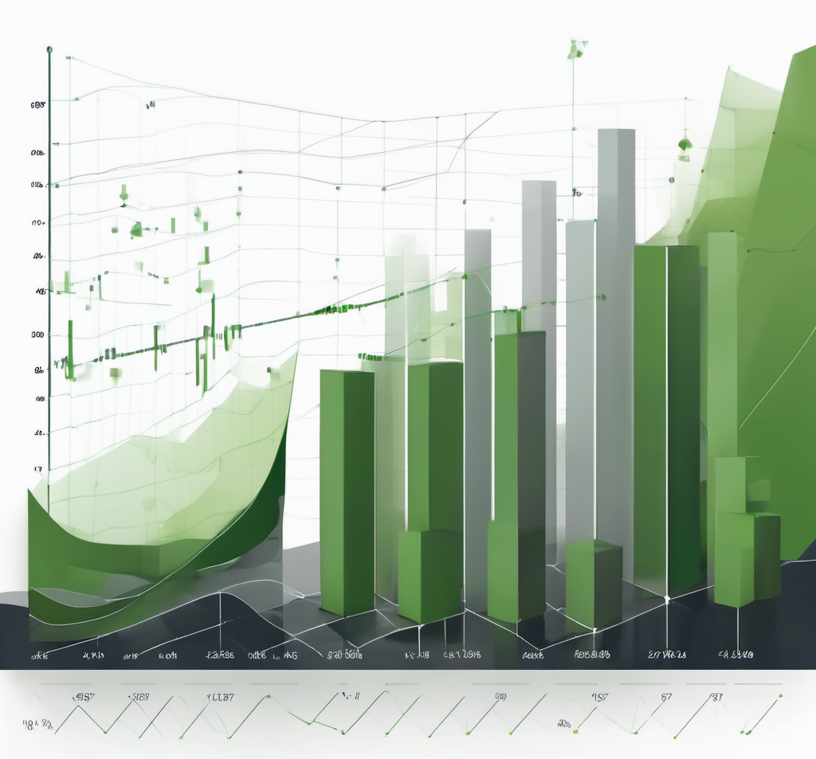
Project Overview
Dataset Dictionary
The accounting measures are categorized below with their detailed definitions, and how credit risk might be affected:
13.Miscellaneous Ratios: Include various other ratios that provide insights into financial performance, such as net worth to assets and current asset turnover rate.
By categorizing the accounting measures with their corresponding labels, makes it easy to refer to specific ratios and assess a company's financial health, risk profile, and creditworthiness. It is essential to consider multiple ratios within each category to gain a comprehensive understanding of a company's financial position and credit risk. Comparing these ratios to industry benchmarks and historical trends further enhances the assessment.

Slide 12
Project Overview
Profitability Ratios:
C1.ROA(C) - Return On Total Assets(C): Measures the company's ability to generate earnings from its total assets. Higher ROA indicates better profitability and lower credit risk as the company efficiently utilizes its assets.
C2.ROA(A) - Return On Total Assets(A): Measures the company's ability to generate earnings from its total assets after tax. Higher ROA(A) implies better profitability and lower credit risk.
C3.ROA(B) - Return On Total Assets(B): Measures the company's ability to generate earnings from its total assets after tax and depreciation. Higher ROA(B) indicates better profitability and lower credit risk.
C4.Operating Gross Margin: Calculates the percentage of gross profit from net sales. Higher margin implies better profitability and lowers credit risk.
C5.Realized Sales Gross Margin: Indicates the realized gross profit percentage from net sales. Higher margin implies better profitability and reduces credit risk.
C# = Column Number

Slide 13
Project Overview
Profitability Ratios:
C6.Operating Profit Rate: Shows the percentage of operating income to net sales. Higher operating profit rate indicates better operational efficiency and lowers credit risk.
C7.Pre-tax Net Interest Rate: Measures the proportion of pre-tax income to net sales. Lower rate is favorable, as it suggests the company has enough earnings to cover interest expenses, reducing credit risk.
C8.After-tax Net Interest Rate: Indicates the proportion of net income to net sales. Lower rate is favorable, indicating better ability to cover interest expenses and lower credit risk.
C9.Non-industry Income and Expenditure/Revenue: Net Non-operating Income Ratio. Measures non-industry income and expenditure as a percentage of revenue. Lower ratio is favorable, as non-industry activities can be volatile and increase credit risk.
C10.Continuous Interest Rate (After Tax): Continuous interest rate after tax and excluding disposal gain or loss, indicating the cost of debt financing. Higher interest rate may increase financial stress and credit risk.
C# = Column Number

Slide 14
Project Overview
Profitability Ratios:
C19.Persistent EPS in the Last Four Seasons: Measures the trend of earnings per share (EPS) over the last four seasons. Consistently positive growth indicates financial stability and lowers credit risk.
C20.Cash Flow Per Share: Indicates the amount of cash generated per outstanding share. Higher cash flow per share means the company has more liquidity to meet obligations, reducing credit risk.
C16.Net Value Per Share (B) - Book Value Per Share(B): Indicates the book value of equity per outstanding share. Higher net value per share suggests a more stable financial position and lower credit risk.
Similarly all other Ratios such as:
2.Liquidity Ratios, 3.Leverage Ratios, 4.Activity or Efficiency Ratios, 5.Cash Flow Ratios, 6.Solvency Ratios, 7.Coverage Ratios, 8.Profitability Growth Ratios, 9.Inventory Management Ratios, 10.Activity Turnover Ratios, 11.Working Capital Ratios, 12.Liability-Related Ratios, 13.Miscellaneous Ratios have been explained in the python notebook in text cell. Refer for details.
C# = Column Number

Slide 15
Exploratory Data Analysis: Data Exploration
1
Data Shape and Types
2
Null Values and Duplicates
The initial exploration of the dataset revealed that it has (6819, 95), and the variables are of the following data types: [float64(93), int64(2)].
We checked the dataset for any missing values and duplicate records. The analysis showed that there are 0 null values and 0 duplicate records in the dataset.
3
Target Variable Distribution
4
Imbalance Ratio
The distribution of the "Bankrupt" target variable shows that 3.22% of the companies in the dataset have filed for bankruptcy, while 96.78% have not.
The imbalance ratio, calculated as the ratio of the majority class (non-bankrupt) to the minority class (bankrupt), is 30.0. This indicates a significant class imbalance, which will need to be addressed during the modeling process.

Slide 16

Exploratory Data Analysis: Numerical Variables
1
Histograms of Key Variables
2
Descriptive Statistics
The histograms of the key numerical variables, such as ROA(A), ROA(B), Net Income to Total Assets, and Debt Ratio %, reveal their distribution patterns and provide insights into the underlying data characteristics.
The descriptive statistics summary, including measures like mean, median, standard deviation, and extremes, offer a comprehensive understanding of the numerical variables in the dataset.
Where we observed that the dataset is normalized in a min max fashion between 0 & 1.
3
Correlation Heatmap
The correlation heat map showcases the relationships between the numerical variables, highlighting the strong correlations that will be further explored in the subsequent analysis.
*** The categorical variables in this dataset are only two out which one is our target variable and the other
one is Liability-Assets Flag during analysis of which we found it doesn’t have much correlation to Bankruptcy

Slide 17
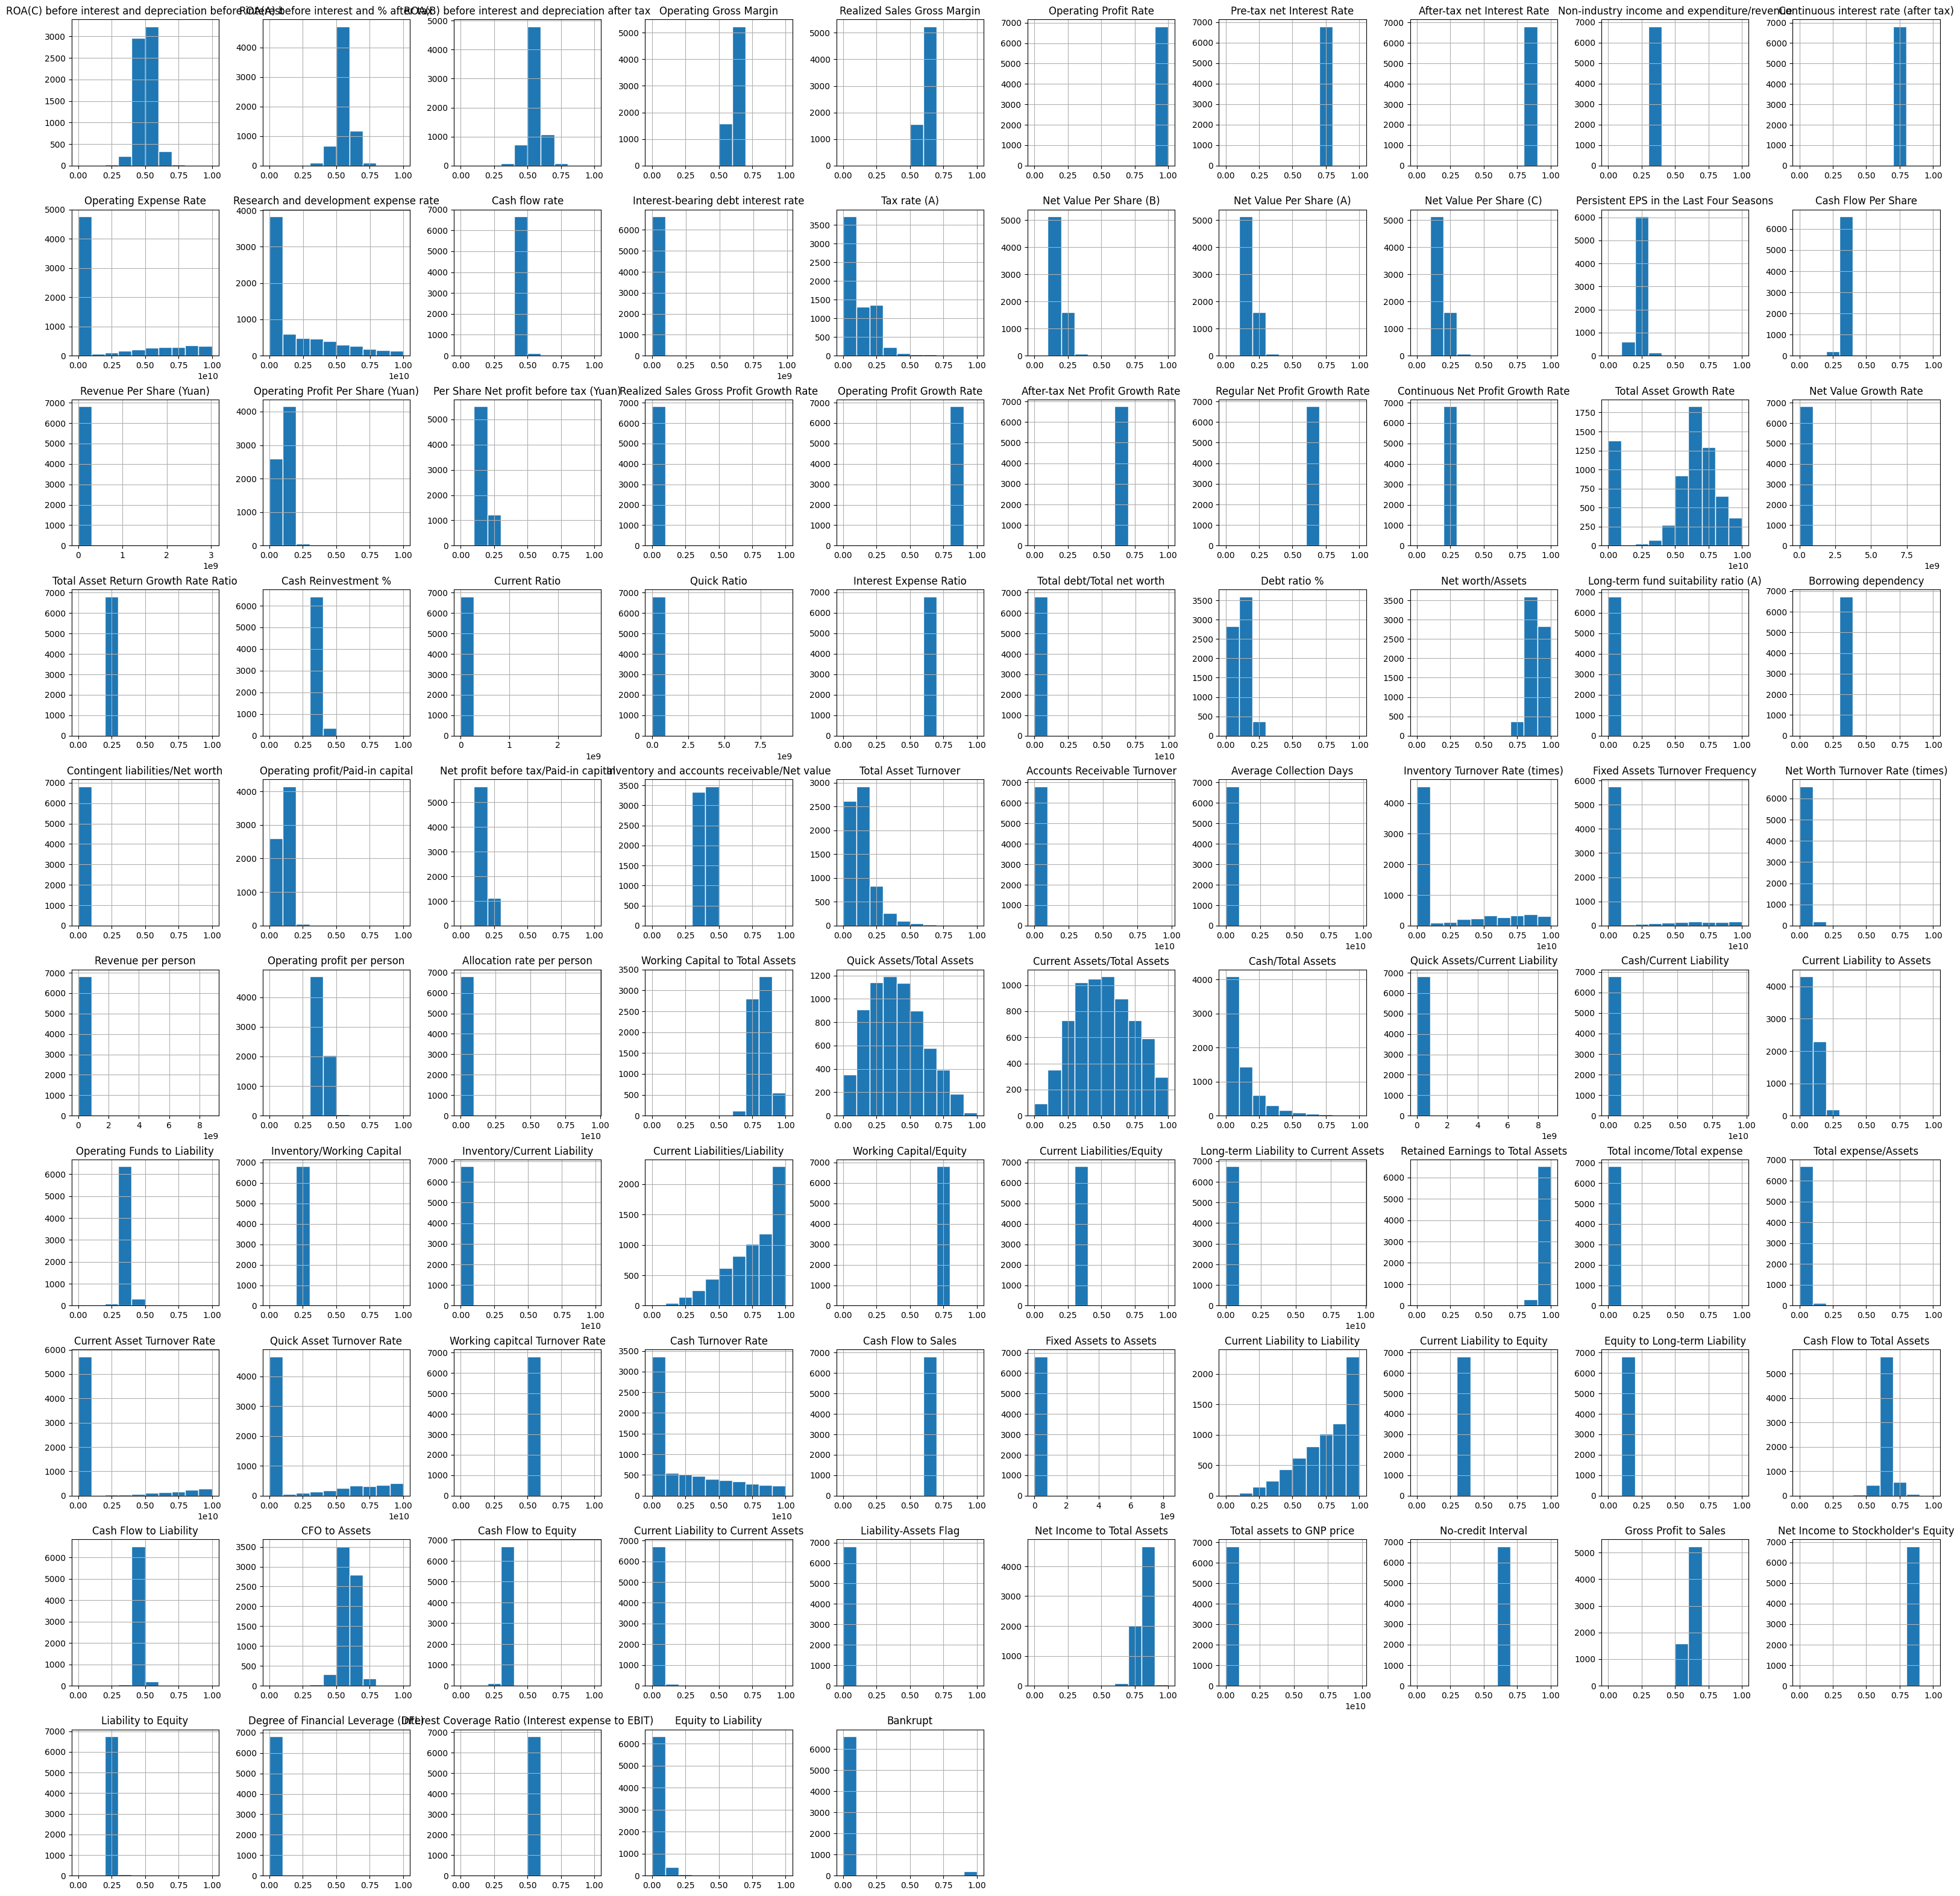
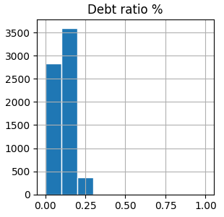

Slide 18

Correlation Analysis and Feature Selection
1
Correlation Analysis
The process of selecting variables based on their correlation with the target variable, "Bankrupt," involved calculating the correlation coefficients and analyzing the correlation heatmap. This step helped identify the most relevant features for the bankruptcy prediction task.
2
Selected Variables
The variables with the strongest correlations with the target variable, 'ROA(C) before interest and depreciation before interest', 'ROA(A) before interest and % after tax', 'ROA(B) before interest and depreciation after tax‘, 'Persistent EPS in the Last Four Seasons', 'Per Share Net profit before tax (Yuan)', 'Debt ratio %', 'Net worth/Assets', 'Net profit before tax/Paid-in capital', 'Retained Earnings to Total Assets‘, 'Net Income to Total Assets
3
Importance of Feature Selection
The careful selection of relevant features is crucial for improving the performance of the bankruptcy prediction models. By focusing on the most informative variables, the models can better capture the underlying patterns and make more accurate predictions.

Slide 19
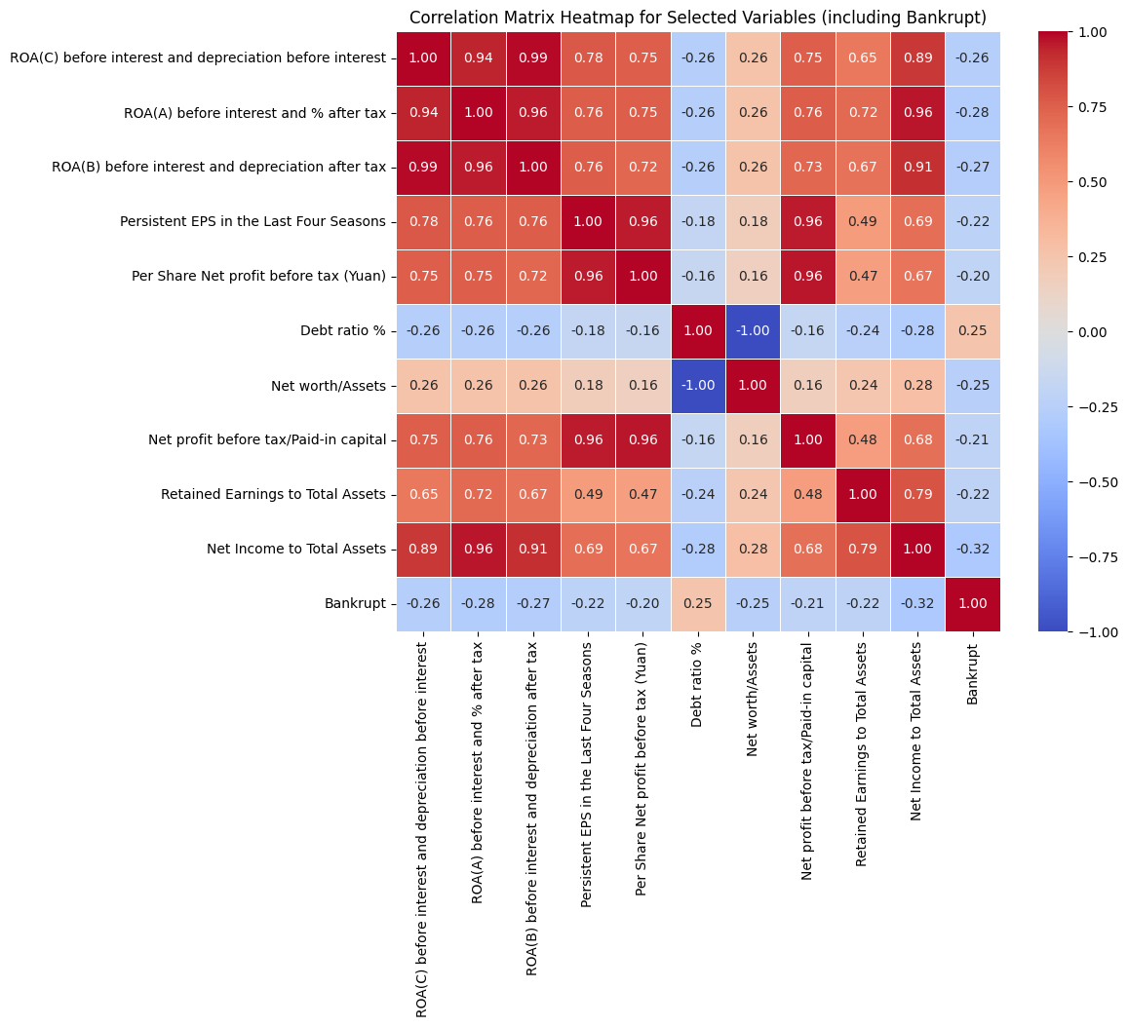

Slide 20
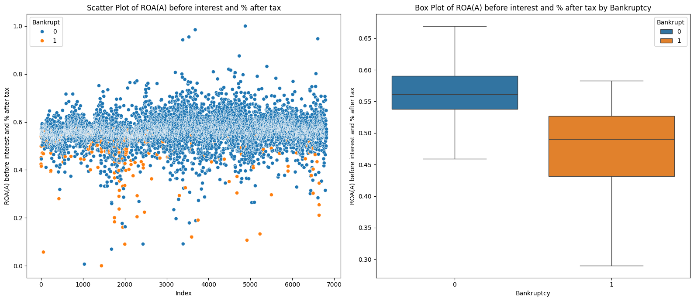
Scatter Plot Analysis
ROA(A) vs Bankrupt
The scatter plot of ROA(A) before interest and % after tax against the Bankrupt target variable shows that Bankrupt companies have mean value of ‘ROA(A) before interest and % after tax’ around 0.5, and non bankrupts have it around 0.57 which means if we are able to have this value above 0.57 then it is highly likely that the company won’t go bankrupt.

Slide 21
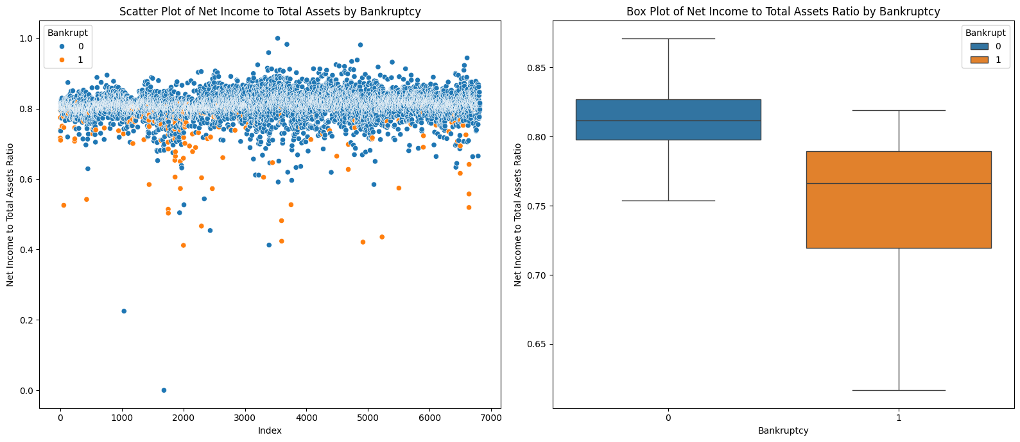
Scatter Plot Analysis
Net Income to Total Assets vs Bankrupt
The scatter plot of Net Income to Total Assets against the Bankrupt target variable shows that Bankrupt companies have mean value of ‘Net Income to Total Assets’ around 0.78, and non bankrupts have it around 0.82 which means if we are able to have this value above 0.82 then it is highly likely that the company won’t go bankrupt.

Slide 22
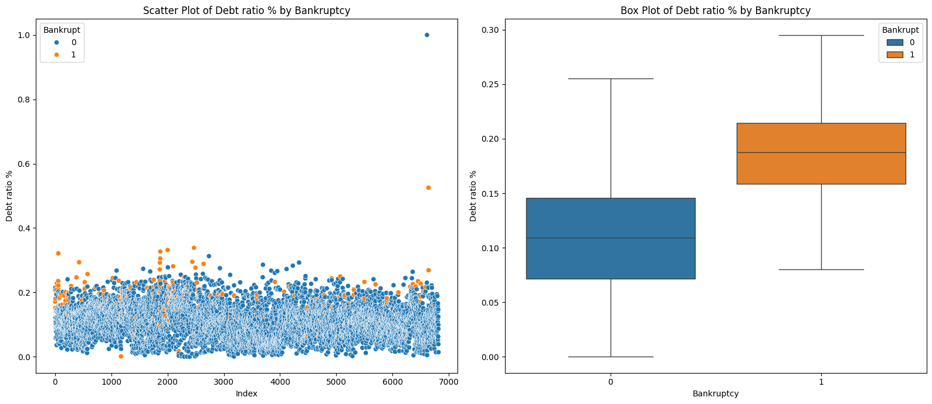
Scatter Plot Analysis
Debt Ratio % vs Bankrupt
The scatter plot of Debt Ratio% against the Bankrupt target variable shows that Bankrupt companies have mean value of ‘Debt Ratio%’ around 0.19, and non bankrupts have it around 0.12 which means if we are able to have this value below 0.12 then it is highly likely that the company won’t go bankrupt.

Slide 23
Creating a Barplot from Seaborn for Accounting ratios
with Highest Absolute Correlation
The correlation coefficients that have an absolute value greater than 0.2 with respect to the "Bankrupt"
variable. These selected variables are stored in the selected_variables Series.
The DataFrame selected_data is then "melted" into a long format, where the "Variable" column contains
the variable names, and the "Value" column contains the corresponding accounting magnitude values.
This is done to prepare the data for creating the bar plots.
The code uses the seaborn library to create a series of bar plots.
Each plot represents one of the selected variables.
The x-axis of each plot shows the variable names, and the y-axis shows the accounting magnitudes.
The bars in each plot are colored differently to represent bankrupt (0) and not bankrupt (1) firms.

Slide 24
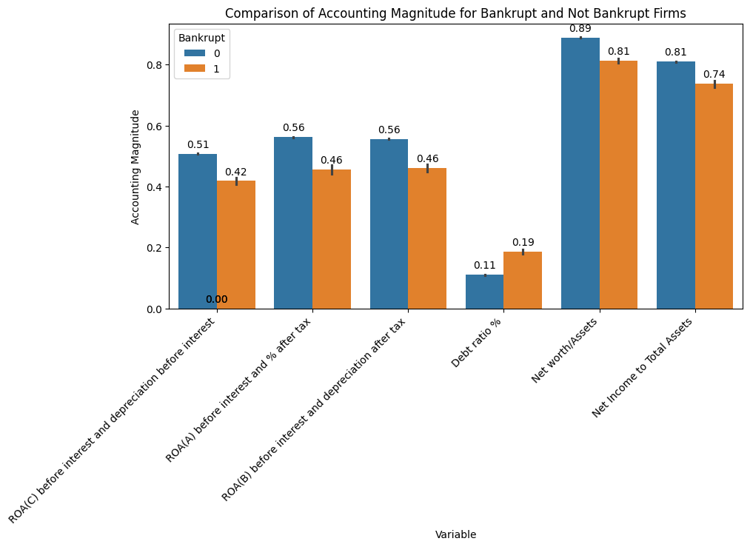

Slide 25
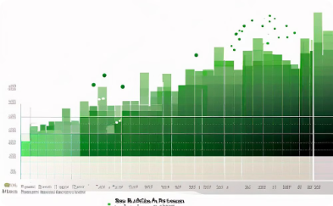
Inference: EDA
Dataset & its properties
1
6819 records for 95 columns, 94 independent & 1 target.
We only have two categorical variables in our dataset, these are of int data type because they only have 0 or 1 as values in their columns. Out of the two categorical variables one is our target variable 'Bankrupt'.
2
Imbalanced Dataset
Our dataset is imbalanced in nature with an imbalance ratio of 30.0 which means our majority class(Non-Bankrupt) is 30 times our minority class(Bankrupt) in the dataset, which is a problem while making ML models as it would severely affect the model accuracy and would end being a majority class biased model.
Best performing independent variables
3
The highly correlated variables gave us a better insight into how we can deduce which company has a higher probability of going bankrupt even before building a ML model, which shows the effectiveness of a good EDA. . Debt Ratio% & Net Income to Total Assets Ratio are both very helpful measures according to this EDA for making a prediction about whether a company would go Bankrupt or not, but because of significantly less datapoints in minority class we can not say that with certainty as well.

Slide 26
Model Building: Preprocessing & Data Scaling
1
Preprocessing
2
Train-Test Split
Splitting the dataset into x & y variables where x contains a dataframe with all the independent variables and y contains the target variable “Bankrupt”.
We use sklearn’s train test split function to divide our data into training & testing data. So that we can train our model with training dataset & evaluate the model with testing data set
3
Scaling the data
We use standard scalar to scale our dataset, Standardization does not change the shape of the distribution of each feature but centers it around zero with a standard deviation of 1. Making it easier to interpret the weights of the features in the model, which represent the relative importance of each feature in the same unit scale.

Slide 27
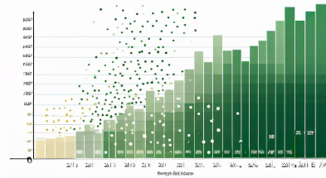
Model Building: With Original Data
Model Building
1
The first step in the model building process involved training various classification algorithms, such as Logistic Regression, Decision Trees, Random Forests, and Gradient Boosting, using the original, unmodified dataset.
2
Performance Metrics
The performance of the models was evaluated using metrics like accuracy, precision, recall, and F1-score. These metrics provided insights into the models' ability to correctly predict bankrupt and non-bankrupt companies.
Impact of Imbalanced Data
3
The analysis revealed that the models struggled to perform well due to the significant class imbalance in the dataset, where the majority of the companies were non-bankrupt. This issue needed to be addressed through appropriate data preprocessing techniques.

Slide 28
Model Performance: With Original Data
 | Recall | Precision | F1_Score | Accuracy
GradientBoostingClassifier | 0.6000 | 0.2308 | 0.3333 | 0.9728
RandomForestClassifier | 0.7500 | 0.1154 | 0.2000 | 0.9717
DecisionTreeClassifier | 0.5000 | 0.1667 | 0.2500 | 0.9709
LogisticRegression | 0.6667 | 0.0769 | 0.1379 | 0.9709

Slide 29
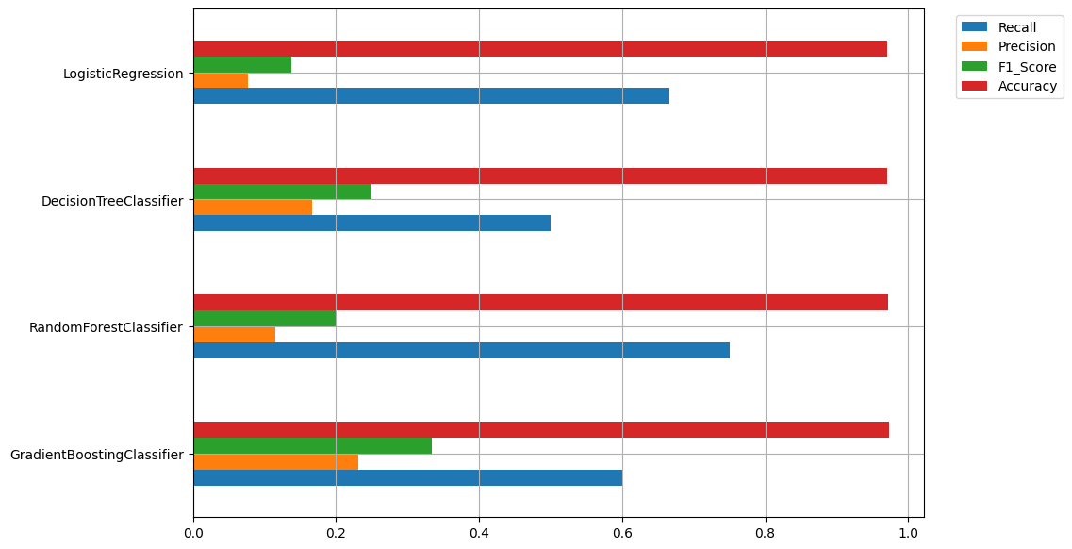
*** Accuracy seems to be very high for all the ML models but that doesn’t directly reflect on how well these models will be able to actually predict Bankruptcy, this high accuracy is because of the data imbalance and these ML models have bumped up their accuracy stats by prediction of ‘Non-bankrupt’ companies which are way more than ‘Bankrupt’ ones because of the data imbalance.

Slide 30
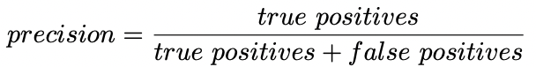
Understanding: Accuracy, Precision, Recall & F1-Score
1
Accuracy
Accuracy is the most common metric to be used in everyday talk. Accuracy answers the question “Out of all the predictions we made, how many were true?”
2
Precision
Precision is a metric that gives you the proportion of true positives to the amount of total positives that the model predicts. It answers the question “Out of all the positive predictions we made, how many were true?”

Slide 31
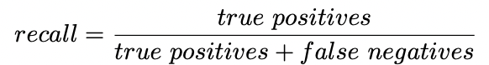
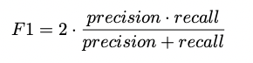
Understanding: Accuracy, Precision, Recall & F1-Score
1
Recall
Recall focuses on how good the model is at finding all the positives. Recall is also called true positive rate and answers the question “Out of all the data points that should be predicted as true, how many did we correctly predict as true?”
2
F1 Score
F1 Score is a measure that combines recall and precision. As we have seen there is a trade-off between precision and recall, F1 can therefore be used to measure how effectively our models make that trade-off.
One important feature of the F1 score is that the result is zero if any of the components (precision or recall) fall to zero. Thereby it penalizes extreme negative values of either component

Slide 32
Model Building Preprocessing: Handling Imbalance
1
Class Imbalance Problem
2
SMOTE Oversampling
3
BorderlineSMOTE
To address the class imbalance, we implemented the Synthetic Minority Over-sampling Technique (SMOTE). This technique generates synthetic examples of the minority (bankrupt) class, effectively balancing the dataset and improving the models' ability to learn from the minority class.
Additionally, we used the BorderlineSMOTE variant of SMOTE, which focuses on generating synthetic examples near the decision boundary between the two classes. This approach helps the models better learn the complex decision boundaries and improve their overall performance.
The bankruptcy prediction dataset exhibited a significant imbalance, with the majority of the companies being non-bankrupt. This class imbalance can negatively impact the performance of machine learning models, as they tend to be biased towards the majority class.

Slide 33
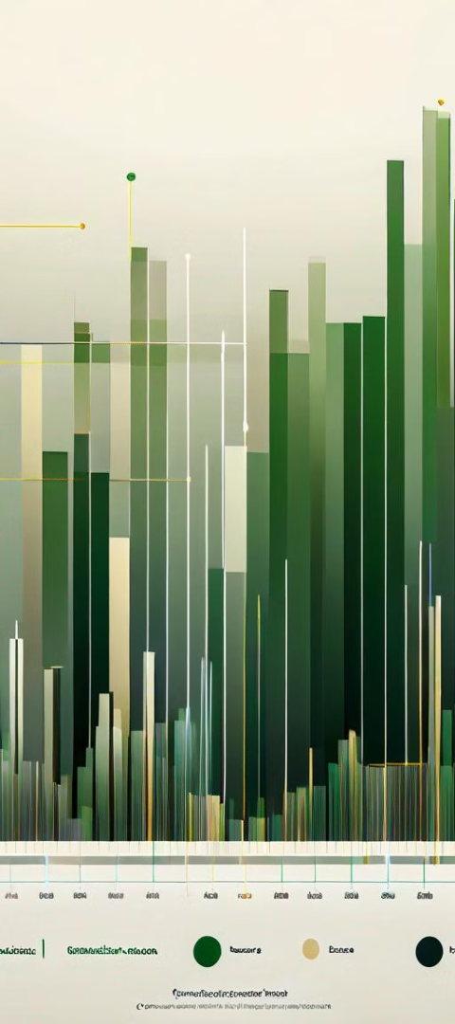
Preprocessing: Data Scaling and Dimensionality Reduction
1
Data Standardization
Using StandardScalar, StandardScaler ensures that all features are on a similar scale, preventing features with larger scales from dominating the learning process.
2
Dimensionality Reduction
Given the relatively large number of input features, we applied Principal Component Analysis (PCA) to reduce the dimensionality of the dataset. This helped to capture the most important information while reducing the complexity of the models.
3
Dropping one from highly correlated pairs
Dropping one feature out of a pair of highly correlated pair helps us reduce the number of columns and thus improving the speed of our ML model.

Slide 34

Model Building: Improved Data
1
Model Training
After addressing the class imbalance through SMOTE oversampling and reducing the dimensionality of the dataset using PCA, we retrained the classification models on the improved dataset. This allowed the models to better learn the underlying patterns and make more accurate predictions.
2
Performance Evaluation
The performance of the models built on the improved dataset was evaluated using the same metrics as before, including accuracy, precision, recall, and F1-score. The results were compared to the models trained on the original, unmodified dataset to assess the impact of the preprocessing techniques.
3
Improved Model Performance
The models trained on the improved dataset, with oversampling and dimensionality reduction, demonstrated significantly better performance across the evaluation metrics. This highlighted the importance of careful data preprocessing in the context of bankruptcy prediction to overcome the challenges posed by imbalanced data.

Slide 35
Model Performance: With Modified Data
 | Recall | Precision | F1_Score | Accuracy
GradientBoostingClassifier | 0.9370 | 0.9803 | 0.9582 | 0.9571
RandomForestClassifier | 0.9826 | 0.9856 | 0.9841 | 0.9818
DecisionTreeClassifier | 0.9328 | 0.9576 | 0.9450 | 0.9410
LogisticRegression | 0.8891 | 0.9174 | 0.9031 | 0.9039

Slide 36
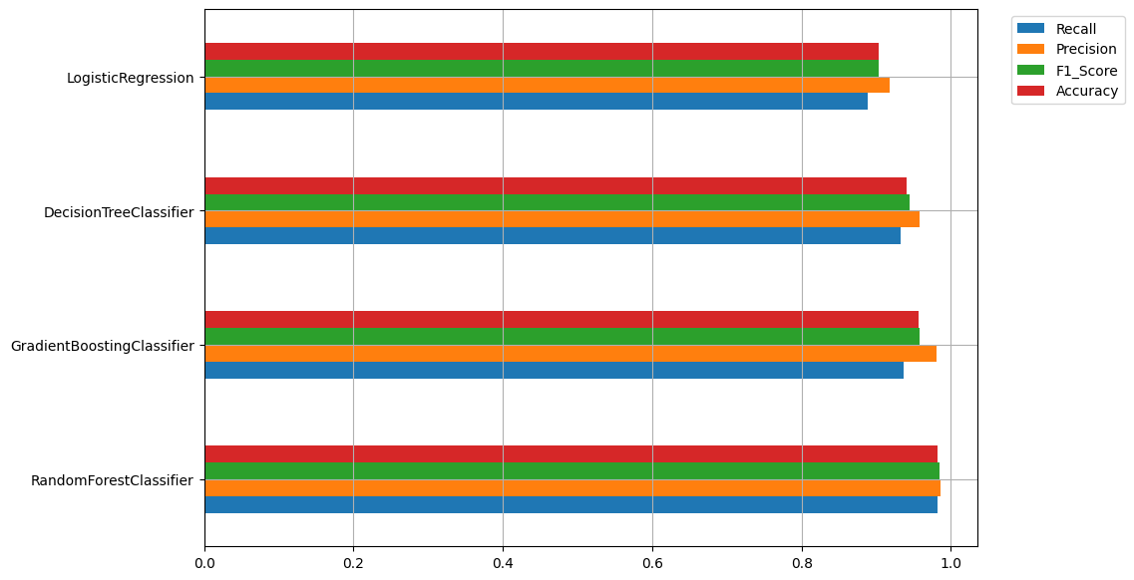
*** In the context of a bankruptcy predictor model, where correctly identifying bankruptcies is crucial for financial stability and risk management, both precision and recall are important. However, since there might be different costs associated with false positives and false negatives, it's often recommended to use the F1 score as the primary performance metric, as it provides a balanced assessment of both precision and recall. And F1 Score of Random Forest is the best hence it will be our final ML model for this project.

Slide 37
Model Comparison and Conclusion
Model Comparison
Key Findings
Final Model: Random Forest
The performance of the models trained on the original dataset and the improved dataset was compared across various metrics, including accuracy, recall, precision, and F1-score. The results clearly demonstrated the benefits of the preprocessing techniques, with the models built on the improved data outperforming the ones trained on the original data.
The project's key findings include the importance of addressing class imbalance through oversampling techniques like SMOTE, as well as the value of dimensionality reduction using PCA to improve the models' performance and generalization capabilities. These insights can be applied to other bankruptcy prediction and financial risk management tasks.
After looking at all the performance parameters against each model we can clearly see that Random Forest is the model which has the best F1 score and which is also our driving parameter for such prediction models as It provides a balance between precision and recall and is particularly useful when there is an uneven class distribution (i.e., imbalanced dataset) or when false positives and false negatives have significantly different costs.

Slide 38
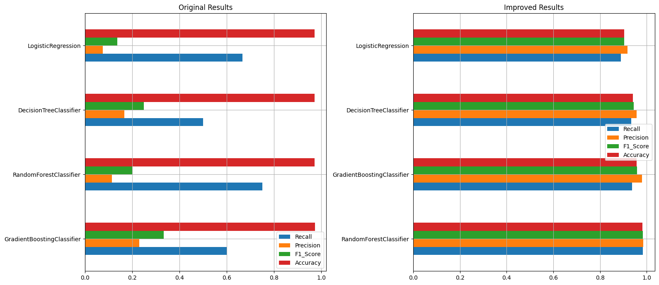

Slide 39

Questions?

Slide 40

References
[1] https://www.labelf.ai/blog/what-is-accuracy-precision-recall-and-f1-score
[2] https://www.analyticsvidhya.com/blog/2016/03/pca-practical-guide-principal-component-analysis-python/
[3] Google Images: For the images other than which are generated by the model

Slide 41

Thank You

